Slide 1
Board Game Break w/ the Software Guild
Why we game – the fun & profit!

Slide 2


Slide 3


Hello from the Software Guild!
Alan Galloway
agalloway@thesoftwareguild.com
Austyn Hill
ahill@thesoftwareguild.com

Slide 4
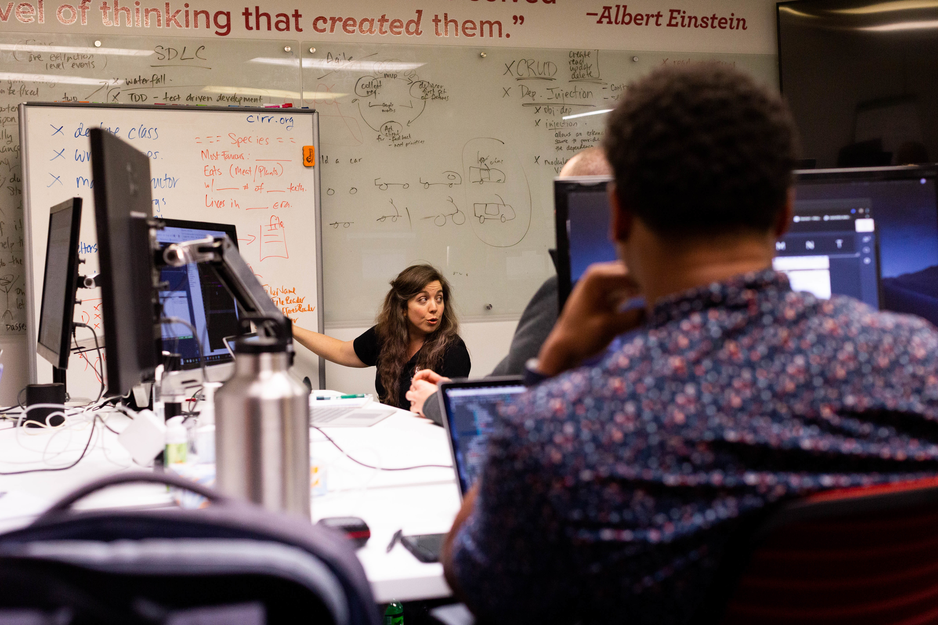
The Software Guild – What do we do?
We run rigorous, intensive and career focused programs to teach people to become developers.
Apprentice model
Multiple Modalities
Full tech stacks

Slide 5
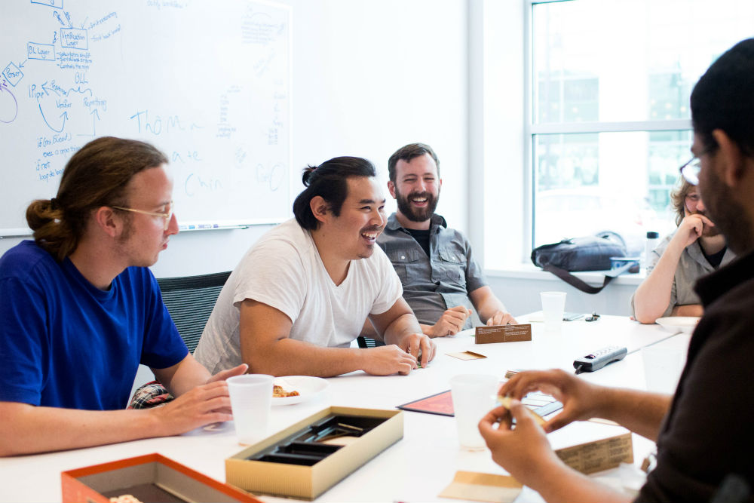
…. but why board games?
Fun!
Networking
Problem solving
Soft skills

Slide 6
FUN!

Slide 7

Llamas Unleashed
General Info:
2-8 Players
30 – 45m
QuickStart
Hoard fuzzies
Sabotage other herds
Expect the Illamanati

Slide 8

Flapjacks & Sasquatches
General Info:
2-8 Players
20 – 40m
QuickStart
Chop trees!
Sabotage opponents
Kiss Sasquatches!

Slide 9

Exploding Kittens
General Info:
2-5 Players
15m
QuickStart
Kitten Roulette
Last cat standing
Simple & approachable

Slide 10

Marrying Mr. Darcy
General Info:
2-6 Players
30 – 60m
QuickStart
Rewrite Jane Austen
Hoard wit, but be careful of the officers!
Simple & Silly

Slide 11
Networking …?

Slide 12

Coup
General Info:
2-6* Players
15m+
QuickStart
Secret roles
Last one standing
Social Deduction & Bluffing

Slide 13

Space team
General Info:
3-6 Players
5 – 10m
QuickStart
You’re in space.
Cooperative
Pass the space dinglehopper, fast!

Slide 14

Bang! The Dice Game
General Info:
3-8 Players
20 – 35m
QuickStart
Save the Sherriff!
(or maybe shoot’em)
Social Deduction & Luck

Slide 15

Camel Up
General Info:
2 - 8 Players
20 – 40m
QuickStart
Betting – win the most!
Googly eyes & stacking camelids.
Light strategy

Slide 16
Problem Solving ...?

Slide 17
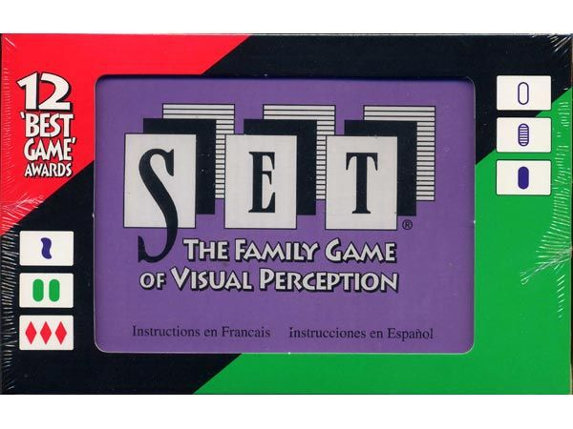
Set
General Info:
1+ Players
As long as you like…
QuickStart
Pattern-matching, the game!
Practice makes perfect.

Slide 18

Potato Pirates
General Info:
3 - 6 Players
20 – 45m
QuickStart
Yer a spud
Become the king!
Maybe learn some programming too.

Slide 19

Fluxx
General Info:
2 - 6 Players
5 – 45m
QuickStart
The only constant is change
Think outside the box. Change the box!

Slide 20

Tricky Tides
General Info:
2-4 Players
30+m
QuickStart
Trick taking & Trade
Beware the Kraken!
Steal all the coffee.

Slide 21
Soft Skills…?

Slide 22

The Mind
General Info:
2 – 4* Players
15m+
QuickStart
Practice your ESP
It’s just counting
But it’s way harder than you think

Slide 23

Decrypto
General Info:
3-8 Players
20 – 50m
QuickStart
Spies & Codes
Team Cooperative
Logical & Social Deduction

Slide 24

Spyfall
General Info:
3-8 Players
15 – 30m
QuickStart
Someone’s a spy, find them! (or hide)
Semi Cooperative
Social Deduction via questions

Slide 25
Enjoy some gaming!
& Hope to See you at Toast to Women in Tech!
Hope to see you around sometime (maybe come visit for a game night!)
& don’t forget to enter our drawing to win a game at the end of the session!
Toast To Women in Tech
Where? The Spire @ Hyatt Regency Louisville
When? Fri, August 23, 2019 5:30 PM – 7:30 PM EDT

